Slide 1
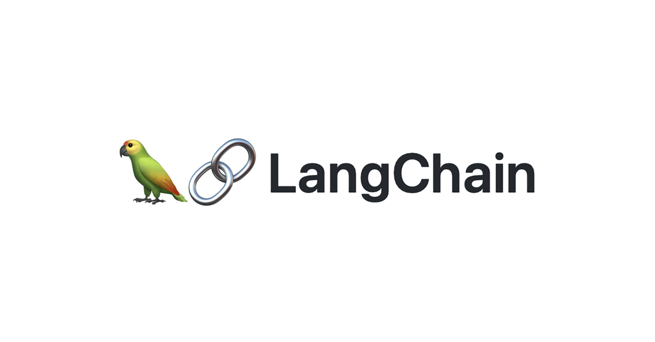
RAG from scratch: Query Translation
(Multi-Query)
Lance Martin
Software Engineer, LangChain
@RLanceMartin
Notes:
Query rewriting is a popular strategy to improve retrieval. Multi-query is an approach that re-writes a question from multiple perspectives, performs retrieval on each re-written question, and takes the unique union of all docs.
Re-write question from multiple perspectives for independent retrieval.
Slides:
https://docs.google.com/presentation/d/15pWydIszbQG3Ipur9COfTduutTZm6ULdkkyX-MNry8I/edit?usp=sharing
Code:
https://github.com/langchain-ai/rag-from-scratch/blob/main/rag_from_scratch_5_to_9.ipynb

Slide 2
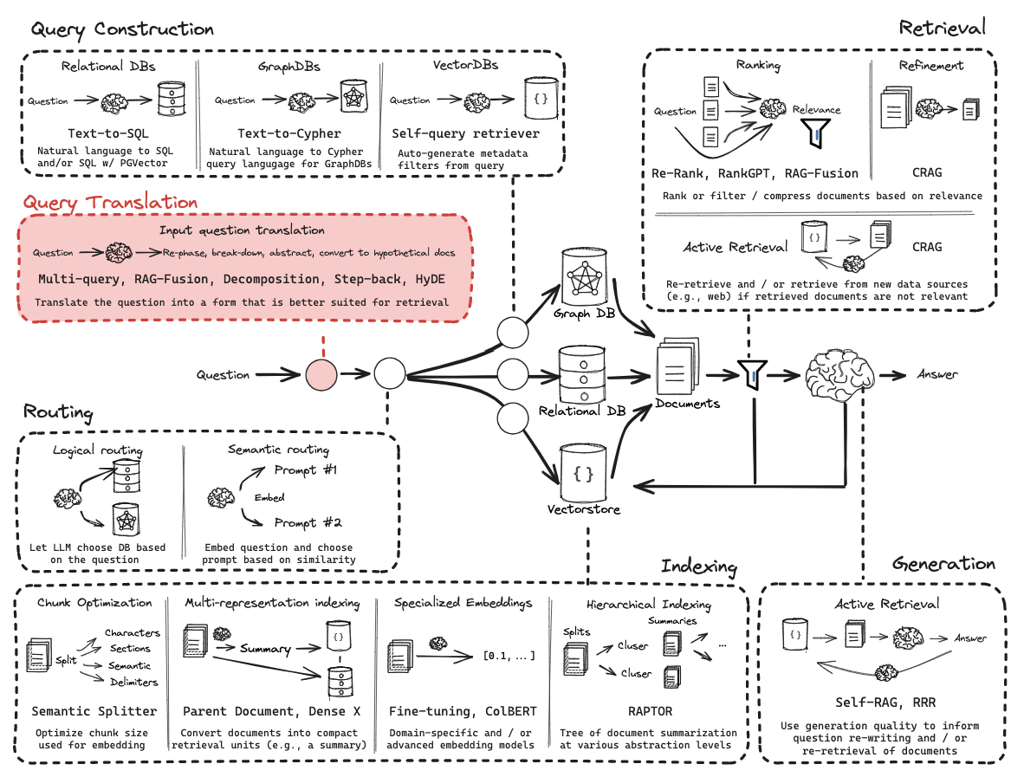
Query Translation

Slide 3
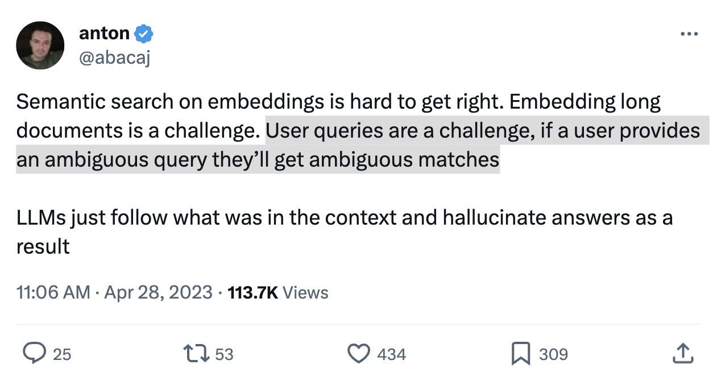
Problem statement
https://twitter.com/abacaj/status/1652011519863926786?s=20

Slide 4
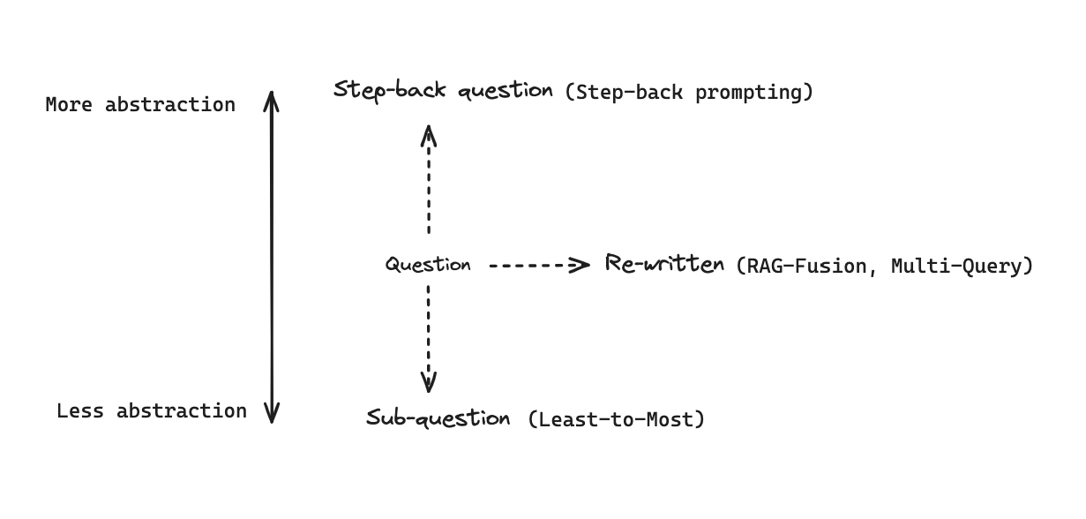
General approaches to transform questions
https://python.langchain.com/docs/modules/data_connection/retrievers/MultiQueryRetriever

Slide 5
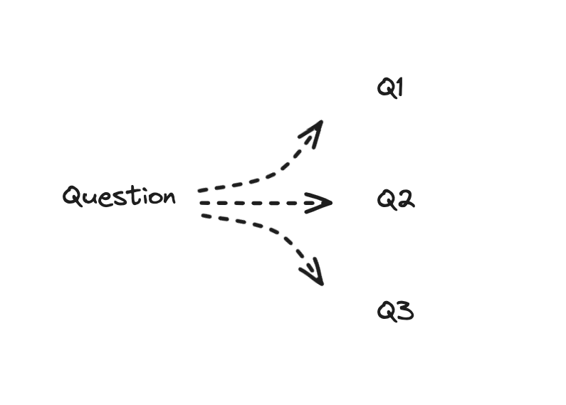
Transform a question into multiple perspectives

Slide 6
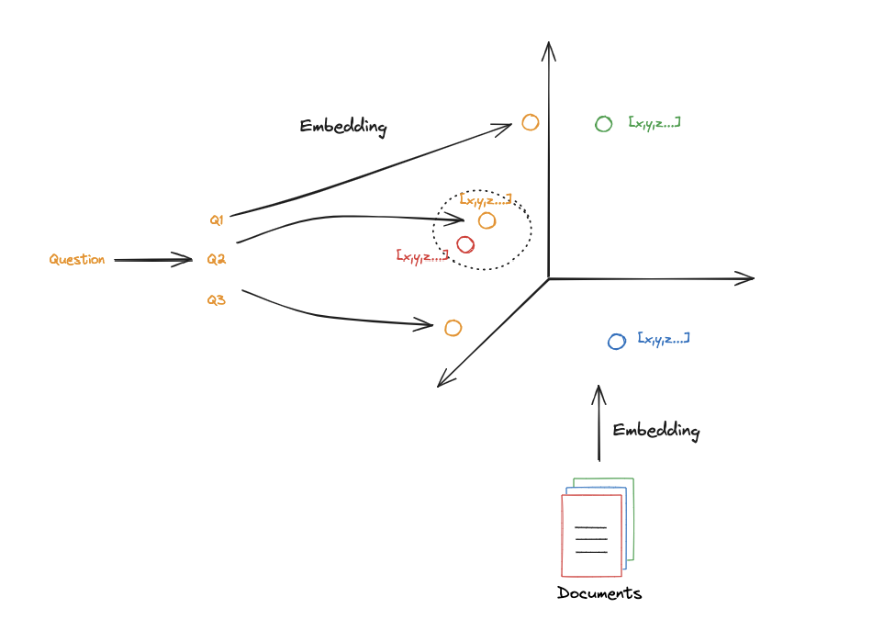
Intuition: Improve search

Slide 7
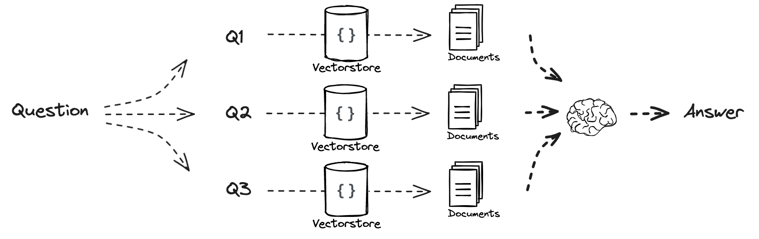
Use this with parallelized retrieval

Slide 8
Code walk-through

